Slide 2

Autobook
Schedule your life tomorrow, today

Slide 3
What is Autobook?
Android application
Merges all your smartphone interactions into one application
Allows you to schedule automatic communication through social media & text messaging
Examples: Never miss your best friend’s birthday, Tweet at your brother on his anniversary, or message all of your friends an hour before the party to remind them, ALL PLANNED IN ADVANCE SO YOU DON’T HAVE TO TOUCH ANYTHING!
Seemless, Simple, Brilliant

Slide 4
Prototype Demonstration
Create Event
Save Event
Receivers
OAuth & Twitter

Slide 5
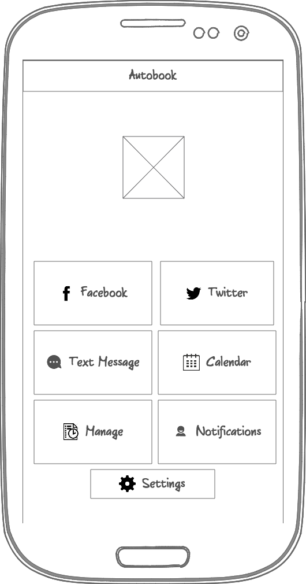
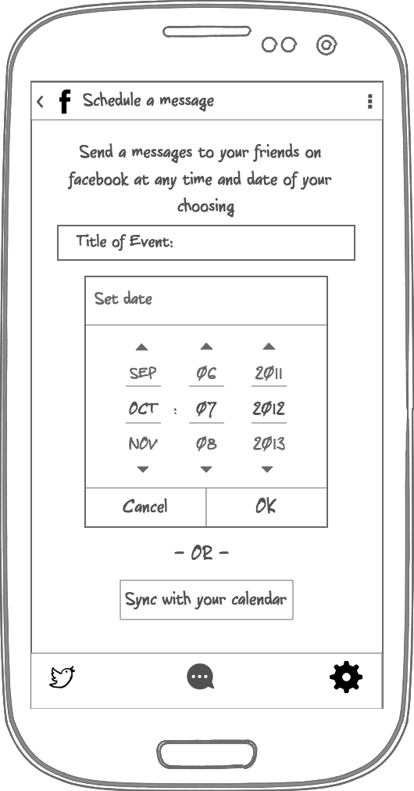
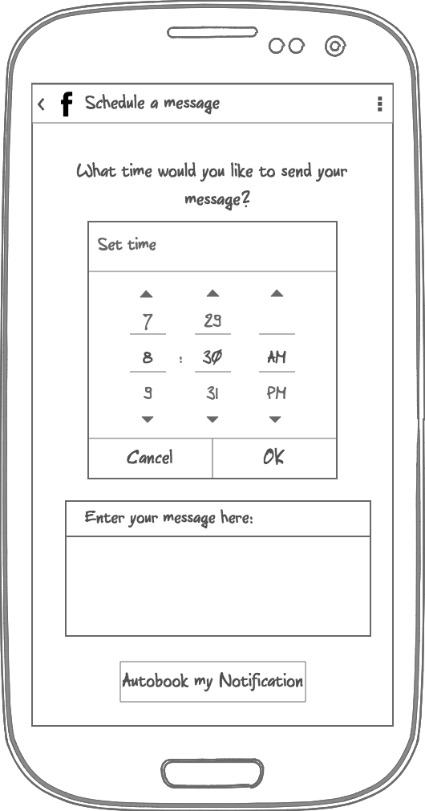
UI Design

Slide 6
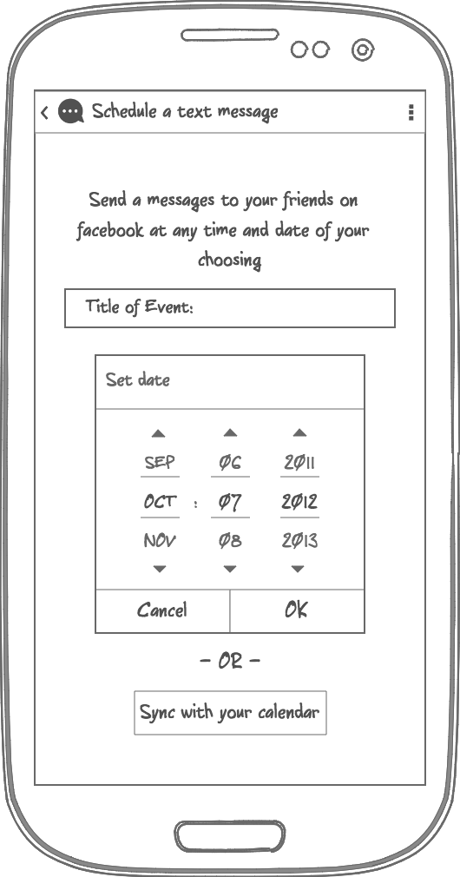
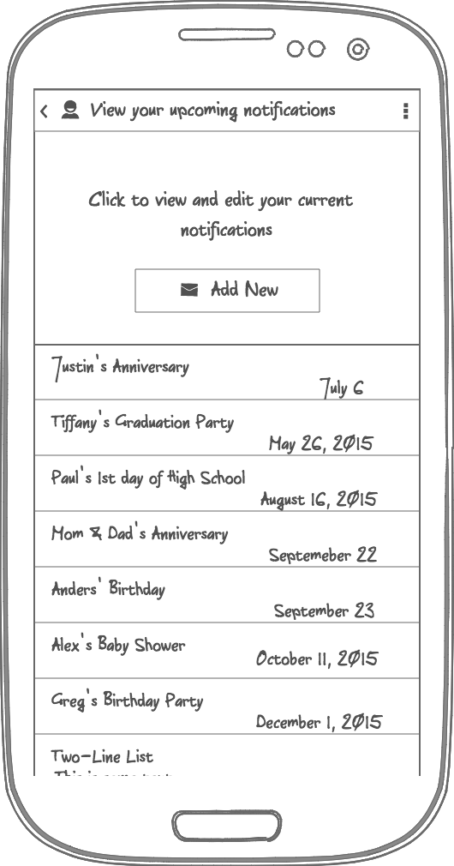
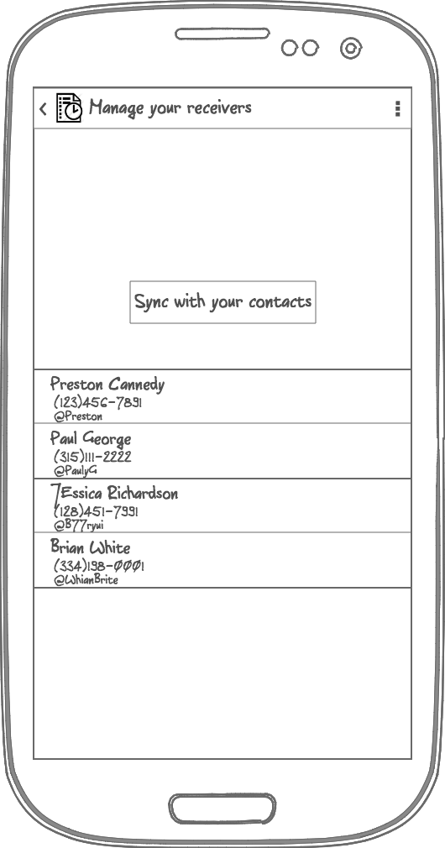
UI Design

Slide 7
UI Implementation
WebView
ProgressDialog
Enables you to display web content without having to open the browser
Greatly reduces loadtime since you don’t have to launch another application
We use it to integrate the Twitter OAuth
Informs the user about a task currently being executed
This way you avoid ”blank” loading screens
You know the app hasn’t crashed
Used for sending request to the Twitter API

Slide 8
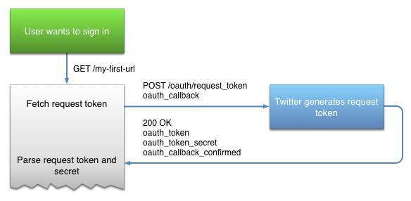
OAuth/Twitter
Step 1: Obtaining a Request Token

Slide 9
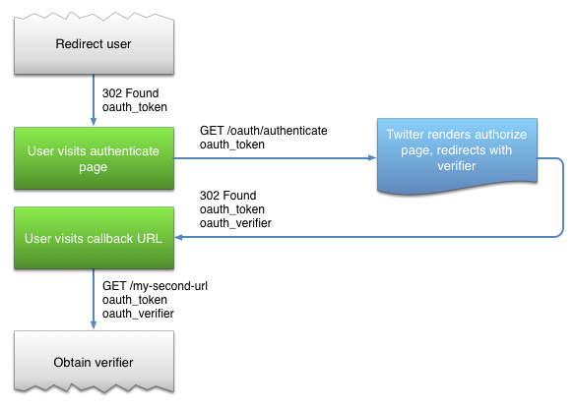
OAuth/Twitter
Step 2: Redirecting the User

Slide 10
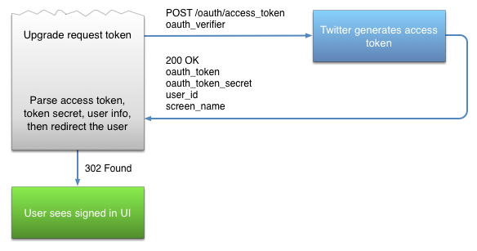
OAuth/Twitter
Step 3: Converting the Request Token to an Access Token

Slide 11
Database
SQLite database created using the SQLiteOpenHelper class and is stored locally on the mobile device.
All queries to the database are done though the class MyDatabaseHandler which simplifies the inputs needed to do a query and does some basic data manipulation to make the data easily readable by other parts of the system.
Database does not support all CRUD commands for every table yet. The next features to be implemented after/during spring break is the ability to update existing rows in the different tables.

Slide 12
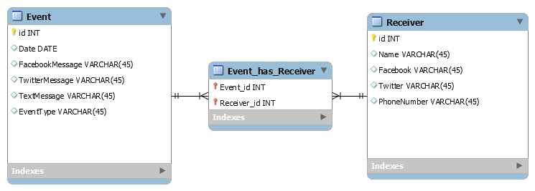
Database

Slide 13
Upcoming Changes
From now till the open house

Slide 14
The Updated Schedule
Task# | Finish Date | Task | Description | Member | Link/Guidance
1 | 1/22/2015 | Learn Android development | Get accustomed to the Android framework, learn how activities & services function, and be comfortable with basic development in the Android Studio IDE | Everyone | http://developer.android.com/guide/index.html
2 | 1/22/2015 | Learn Facebook API (& SDK) | Understand the basic tools available through the API and learn how to use the Facebook SDK for login + messaging | Kenton & Sebastian | https://developers.facebook.com/docs/android?locale=da_DK
3 | 1/22/2015 | Learn Twitter API (& Fabric SDK) | Understand the basic tools available through the API and learn how to use the Fabric SDK for login + tweeting | Kenton & Sebastian | https://dev.twitter.com/products/fabric
4 | 1/29/2015 | Set up code sharing | Create and share a GitHub-repository, and make sure everybody on the team understands how to use it | Sebastian (everybody else create public acounts and install Github for Mac/Windows | https://github.com/
5 | 1/29/2015 | Set up programming environment | Download and run Android Studio (and Android VM) | Everyone
6 | 1/29/2015 | App design on Lucidchart | Design the general look of the User Interface using the available tools on Lucidchart (and sign-up with syr.edu-email for educational license) | Preston | https://www.lucidchart.com/home
7 | 1/29/2015 | Design the database structure | Decide upon what data should be stored in the database, what types they are, and create a schema to illustrate this (think about redundancy) | Anders
8 | 1/29/2015 | Design system architecture | Decide how the system architecture will be set up | Everyone | Refer to SRS
9 | 2/5/2015 | Facebook/Twitter Authentication | Program the user authentication into the application | Kenton & Sebastian | http://oauth.net/
10 | 2/5/2015 | Set-up database | Implement the database related to the structure previously created | Anders
11 | 2/12/2015 | CRUD operations on events | Implement create, read, update, and delete operations for events | Sebastian
12 | 2/12/2015 | CRUD operations on notifications | Implement create, read, update, and delete operations for notifications | Sebastian
13 | 2/19/2015 | Create Initial Layout Files | Program a quick draft of the different layout-files | Preston & Sebastian
14 | 2/26/2015 | Connect with Twitter | Implement the cooperation with the Twitter and Facebook SDKs so the app is able to retrieve information from the social media sites, and also the communication to other users | Kenton & Sebastian
15 | 3/3/2015 | Make prototype presentation |  | Everybody
16 | 3/24/2015 | Scheduler | Within the program, create a scheduling portion that checks the date to see if it matches any events and if so, sends out the request. | Anders | https://developer.android.com/training/scheduling/alarms.html
 |  |  |  |  | https://developer.android.com/reference/android/app/AlarmManager.html
17 | 3/24/2015 | Connect with Facebook | Implement the cooperation with the Twitter and Facebook SDKs so the app is able to retrieve information from the social media sites, and also the communication to other users | Kenton & Sebastian
18 | 3/26/2015 | Investigate and implement SMS | Look into the oppurtunities related to text messaging and implement the result | Sebastian & Preston | http://developer.android.com/reference/android/provider/Telephony.html
19 | 3/31/2015 | Create Final Layout Files | Program the different Views (Activities) according to the App design made on Lucidchart (include different screen size and orientation) | Sebastian & Preston
20 | 4/2/2015 | Create poster for Open House |  | Everyone
21 | 4/7/2015 | Make presentation |  | Everyone
22 | 4/11/2015 | Present at Open House |  | Everyone
- but can anyone actually read this?

Slide 15
Upcoming Changes The User Interface
Android widgets:
DatePicker – a calendar view making easy to select dates
Spinner – represents a drop-down menu which is perfect for Enums (types)
QuickContactBadge – thumbnail that opens a dialog when clicked
Phone and Tablet layouts
Think about orientation (portrait vs landscape)
Make use of the bigger screen size, example on next slide

Slide 16
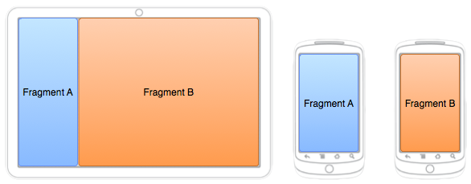
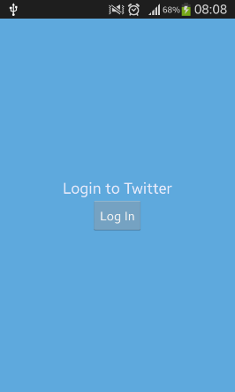
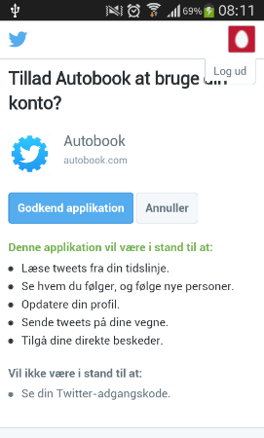
Upcoming Changes The User Interface

Slide 17
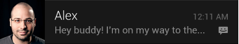
Upcoming Changes The Scheduler
Android class: AlarmManager
Android class: BroadcastReceiver
Notifications (for Facebook Messenger)
(Possibly) Implement sound effects – Android class: MediaPlayer

Slide 18
Upcoming Changes Facebook API
OAuth
Graph API – retrieve birthdays and contact information
Find a way to synchronize with the events in a quick and easy way
Facebook Messenger App – sending messages

Slide 19

Questions?

